Slide 1
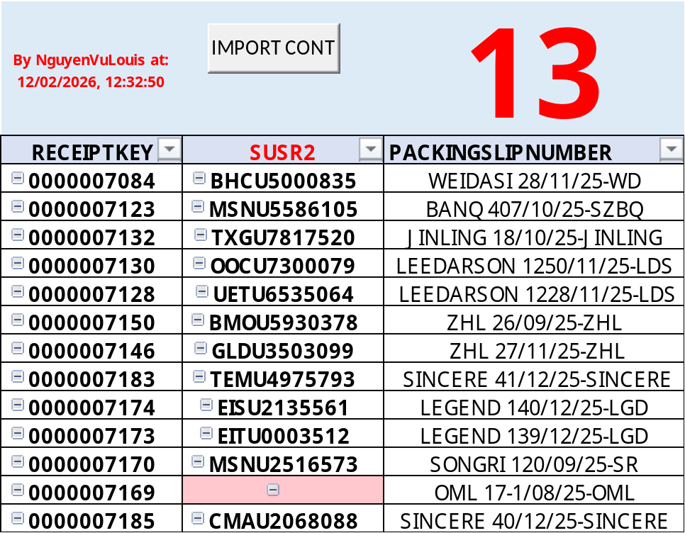
CONT SẮP VỀ

Slide 2
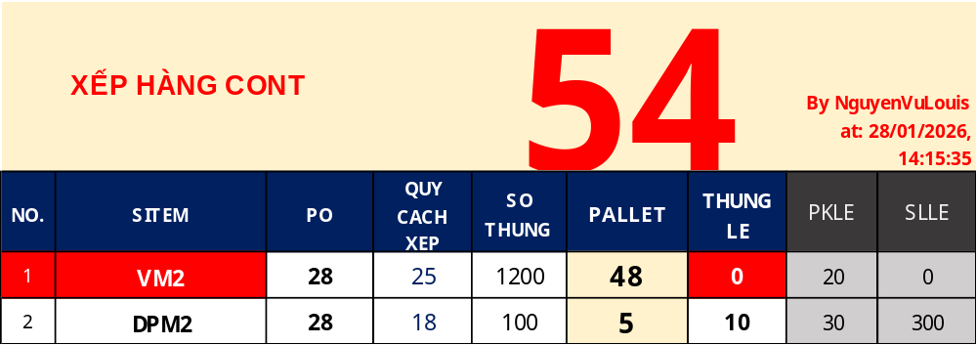
WEIDASI 28/11/25-WD

Slide 3
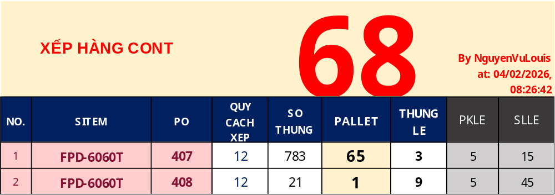
BANQ 407/10/25-SZBQ

Slide 4
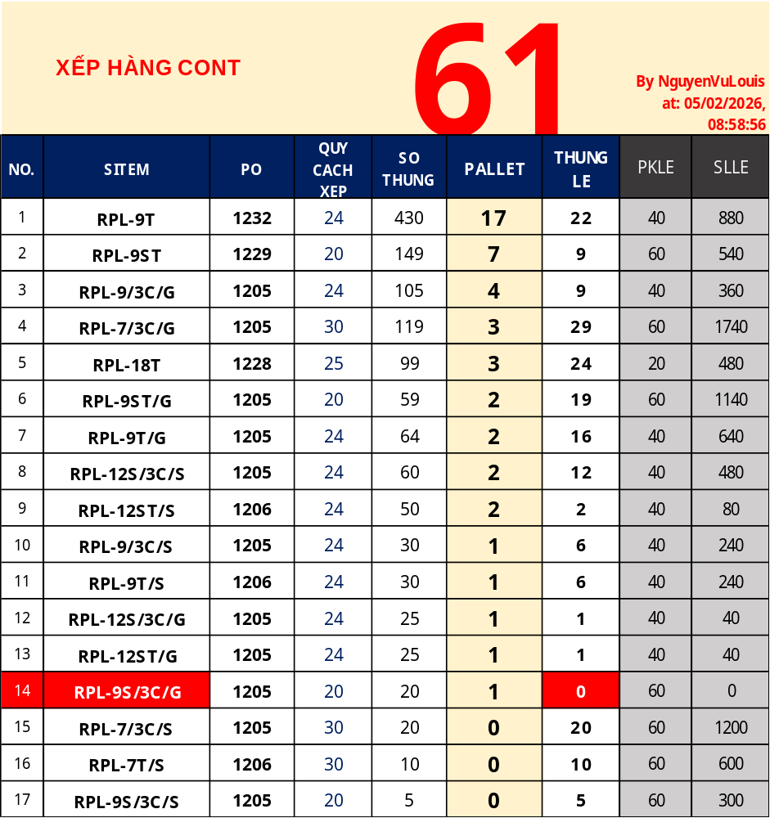
LEEDARSON 1228/11/25-LDS

Slide 5
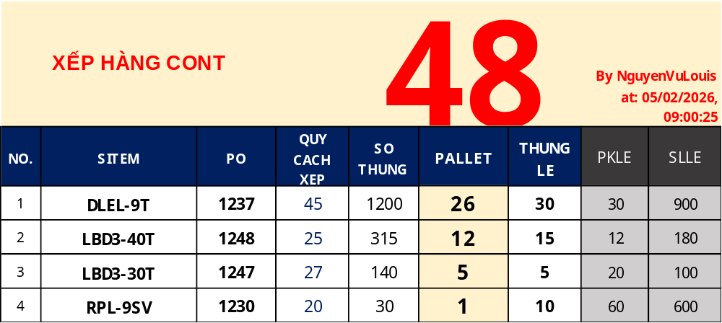
LEEDARSON 1250/11/25-LDS

Slide 6
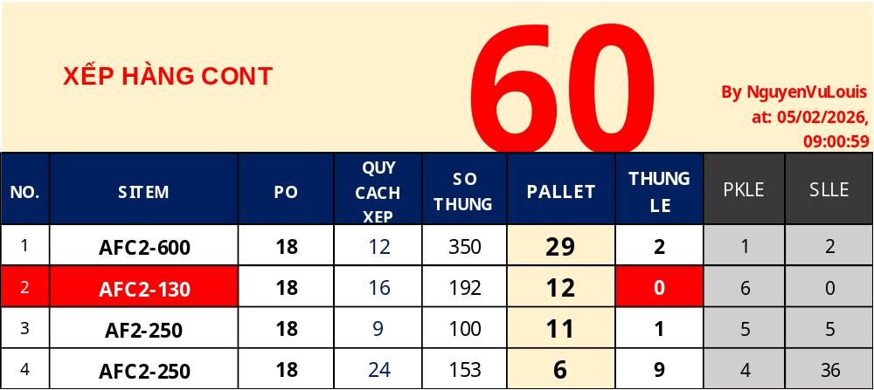
JINLING 18/10/25-JINLING – CON TXGU7817520

Slide 7
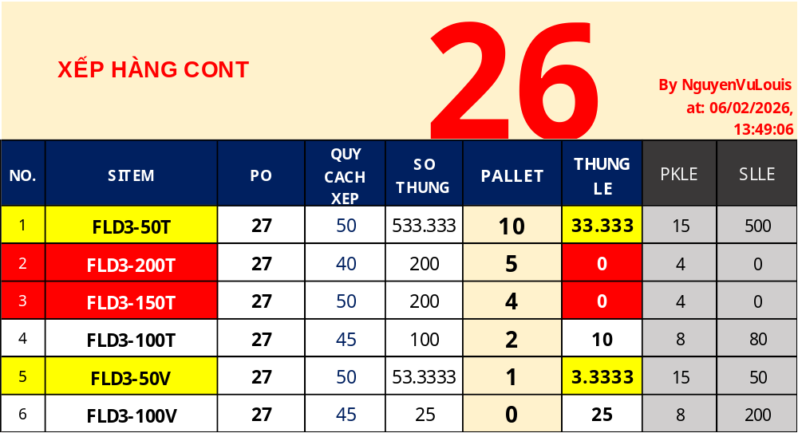
ZHL 27 – CONT GLDU3503099

Slide 8
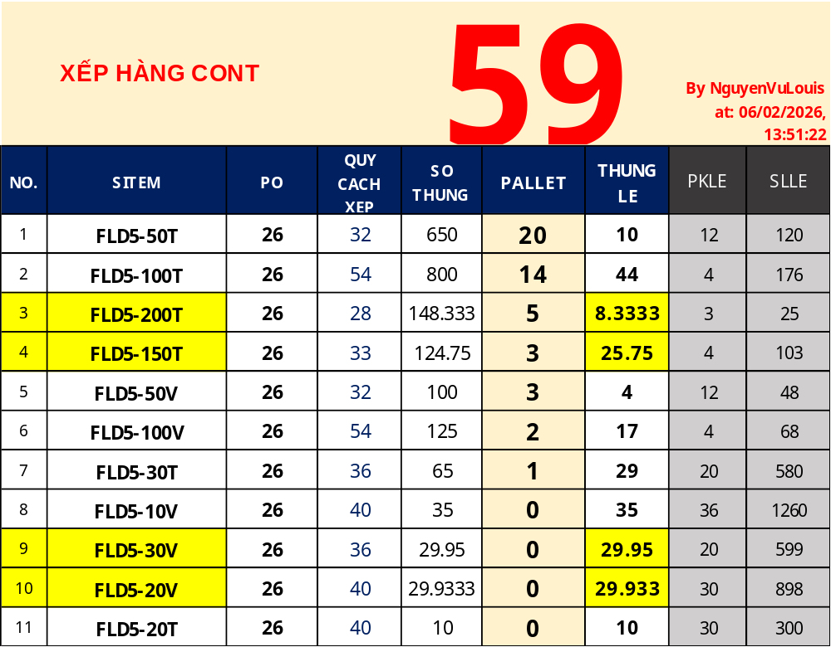
ZHL 26/09/25-ZHL

Slide 9
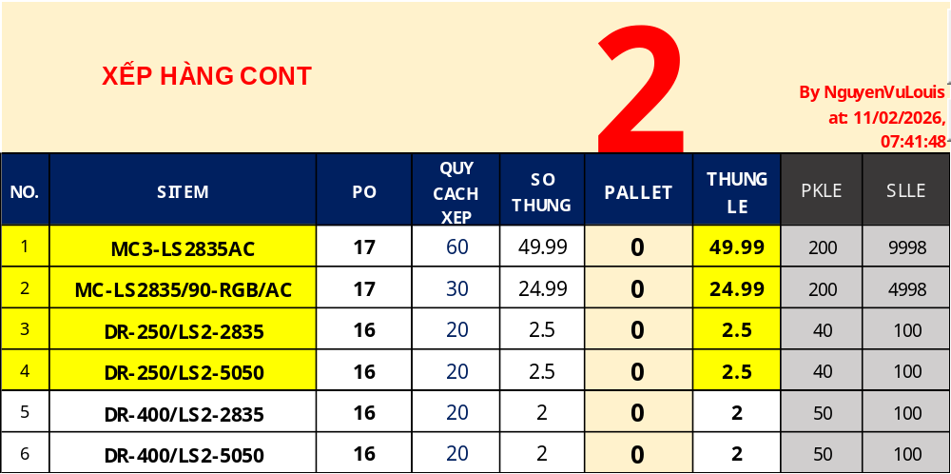
OML 17-1/08/25-OML

Slide 10
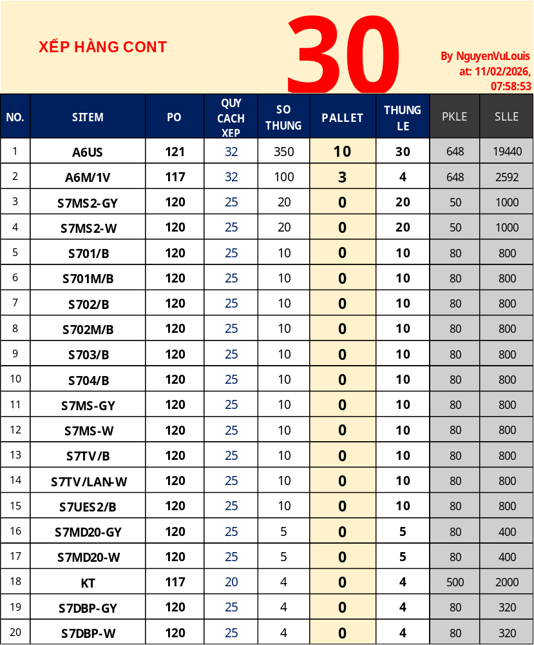
SONGRI 120/09/25-SR

Slide 11
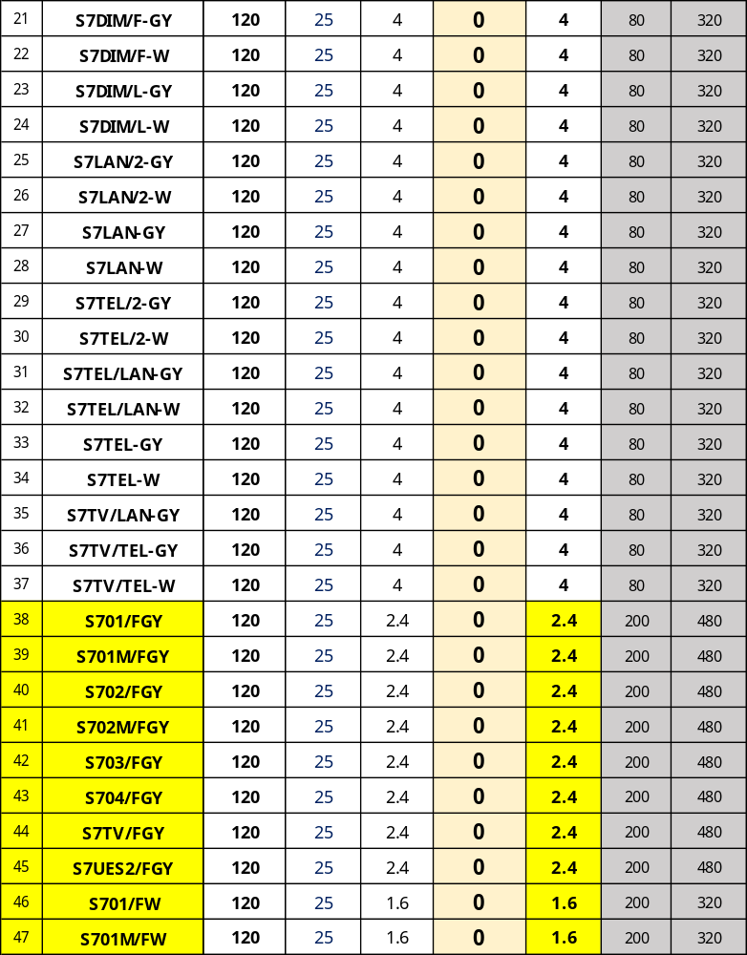
SONGRI 120/09/25-SR

Slide 12
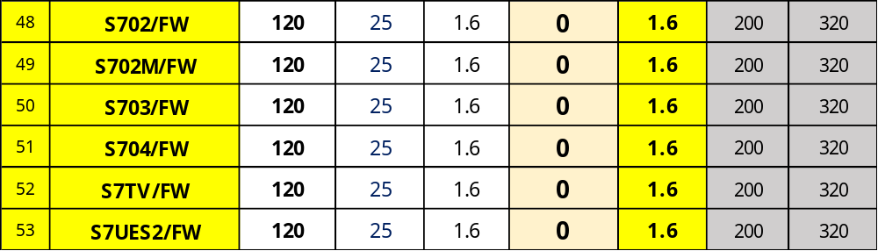
SONGRI 120/09/25-SR

Slide 13
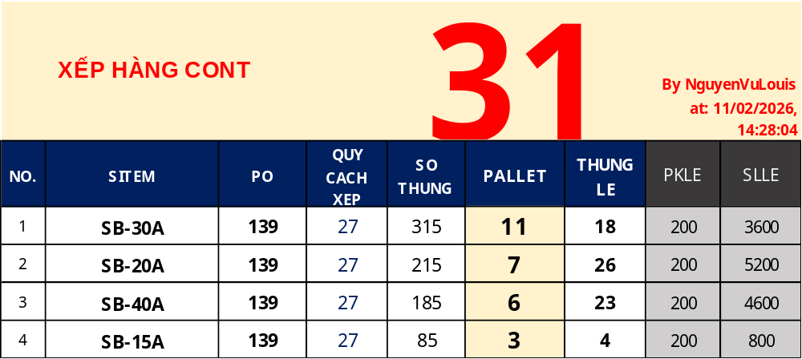
LEGEND 139/12/25-LGD

Slide 14
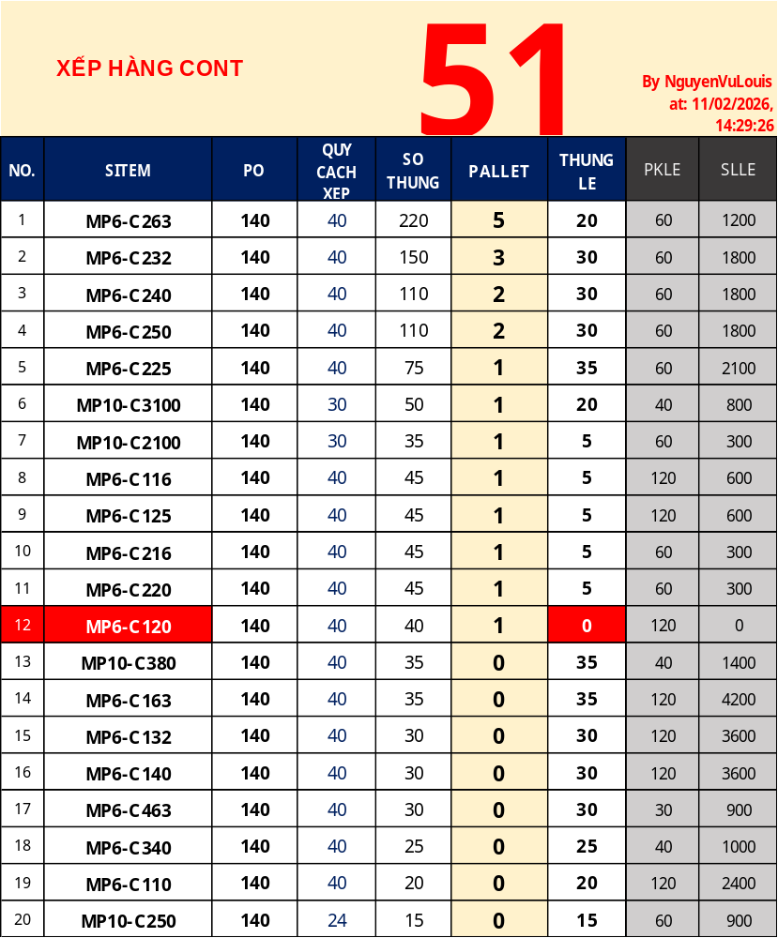
LEGEND 140/12/25-LGD

Slide 15
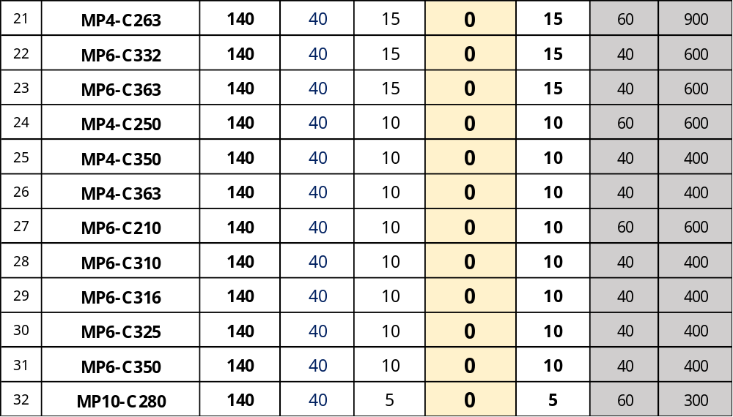
LEGEND 140/12/25-LGD

Slide 16
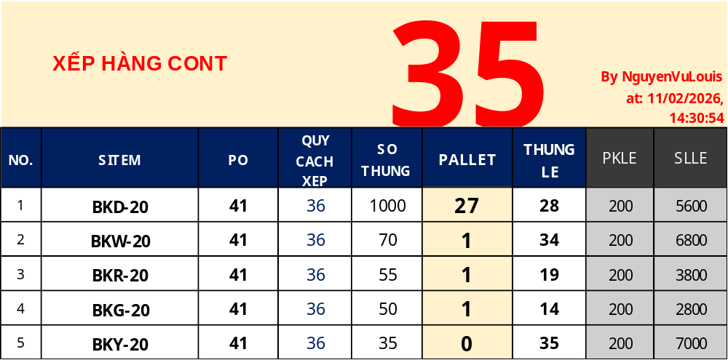
SINCERE 41/12/25-SINCERE

Slide 17

SINCERE 40/12/25-SINCERE

